Slide 1
IBM University Engagement Project Submission
“Exploring the Power of Agentic AI with IBM Granite and IBM Bob”

Slide 2

Project Tile – Fitness Buddy
Domain of Project – Health & Fitness
Student Name | Recent Passport Photo | Email ID | Mobile number [WhatsApp]
Sri Sanjana Gedela |  | srisanjana.g@outlook.com | 9164011551

Slide 3
Problem Statement : Fitness Buddy
The Challenge
In today’s fast-paced world, many individuals struggle to maintain a healthy lifestyle due to lack of personalized guidance, time constraints, and inconsistent motivation. Traditional fitness solutions often require expensive subscriptions, in-person consultations, or rigid schedules that don't adapt to personal preferences or daily routines.

Slide 4
The Objective
Build an AI-powered Fitness Buddy that provides personalized fitness and healthy lifestyle guidance based on the user’s needs. The solution should have:
Home Workout Plans – Recommend simple workout routines that can be done at home without a gym.
Daily Motivation – Provide motivational tips and daily fitness inspiration to help users stay consistent.
Meal Ideas – Suggest simple and nutritious meal ideas for a healthy lifestyle.
Habit Building – Encourage users to build healthy habits and maintain consistency.
Weight Loss Tips – Provide general tips and guidance related to maintaining a healthy lifestyle and weight management.
Recovery Tips – Provide basic recovery and rest-related fitness guidance.
AI Fitness Chatbot – Allow users to ask questions about workouts, meals, motivation, and habit building through a conversational AI interface.

Slide 5
Proposed Solution – AI – Powered Fitness buddy
The proposed solution is an AI-powered Fitness Buddy built using IBM Granite to provide personalized fitness and healthy lifestyle guidance. The system helps users with home workouts, daily motivation, meal ideas, habit building, weight loss tips, and recovery guidance.
At its core, the solution provides a conversational AI fitness coach where users can ask questions related to workouts, nutrition, motivation, and healthy habits and receive personalized responses.
The system provides the following key features:
Home Workout Plan recommends personalized workout routines that can be done at home without a gym.
Daily Motivation provides fitness tips and motivational guidance to help users stay consistent.
Meal Ideas suggests simple and nutritious meal ideas for maintaining a healthy lifestyle.
Habit Building provides ideas to help users develop healthy habits and maintain consistency.
Weight Loss Tips provides general fitness and lifestyle guidance related to weight management.
Recovery Tips provides basic guidance related to rest and recovery after workouts.
The solution includes a user-friendly dashboard with quick access to home workouts, motivation, meal ideas, habit building, weight loss tips, and recovery tips.
IBM Granite powers the conversational AI responses and provides the fitness and lifestyle guidance based on the user’s input.
Overall, this solution provides an accessible and personalized AI fitness assistant that helps users maintain a healthier lifestyle through workouts, nutrition suggestions, motivation, and habit building.

Slide 6
Technology Used
Frontend
HTML5: Builds the structure and content of the Fitness Buddy web interface.
CSS3: Styles the Fitness Buddy interface and creates its clean, user-friendly design.
Vanilla JS: Handles user interactions, chatbot communication, and dynamic content.
Google Fonts: Provides readable and attractive fonts for the Fitness Buddy interface.
Backend
Python 3 – Runs the backend logic of Fitness Buddy.
Flask – Creates the backend server and handles requests from the Fitness Buddy interface.
Flask-CORS- Enables communication between the frontend and backend.
AI & Cloud
IBM Granite-4 Small: Generates personalized fitness, workout, meal, motivation, and habit-building responses.
IBM watsonx.ai: Provides the platform and API access for using the IBM Granite model.
IBM IAM: Handles secure authentication and authorization for accessing IBM cloud services.

Slide 7
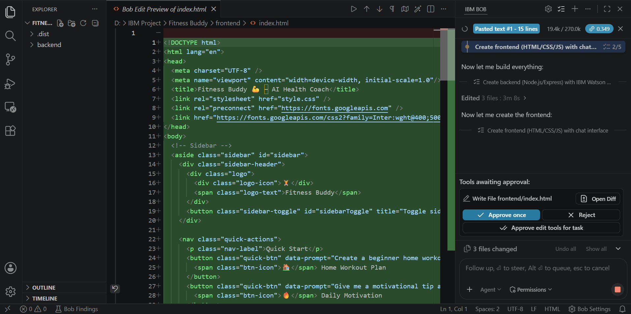
Required Files created using IBM bob -

Slide 8
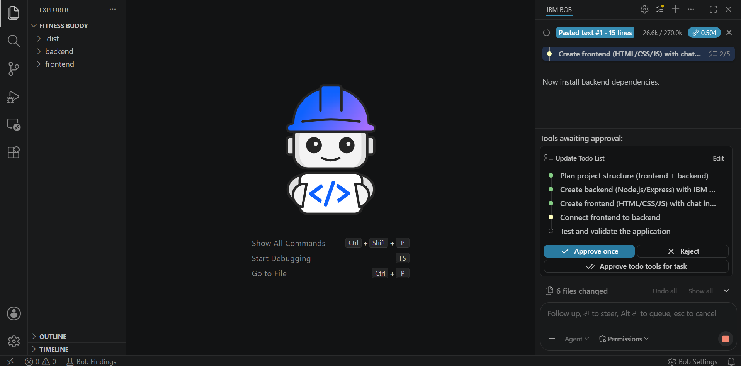
IBM Bob Screenshots:

Slide 9
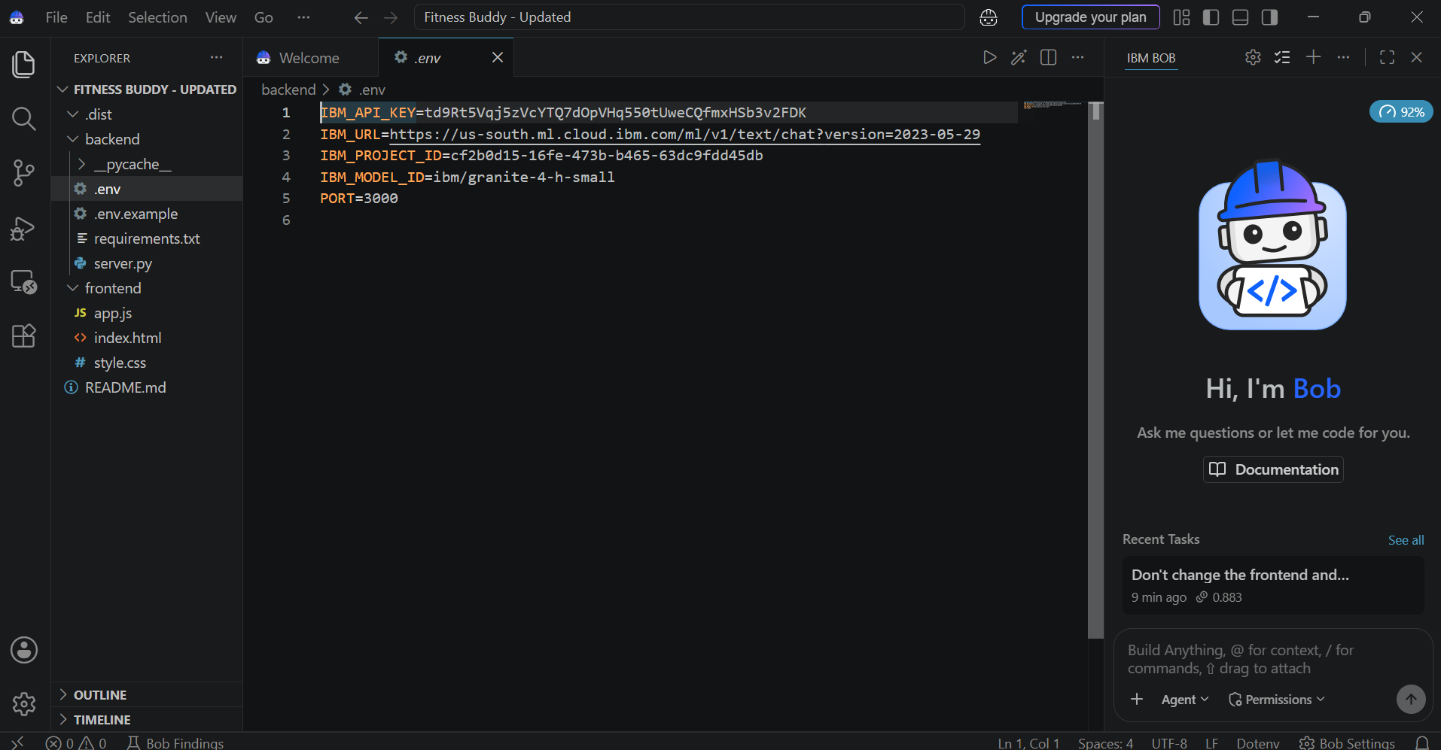

Slide 10
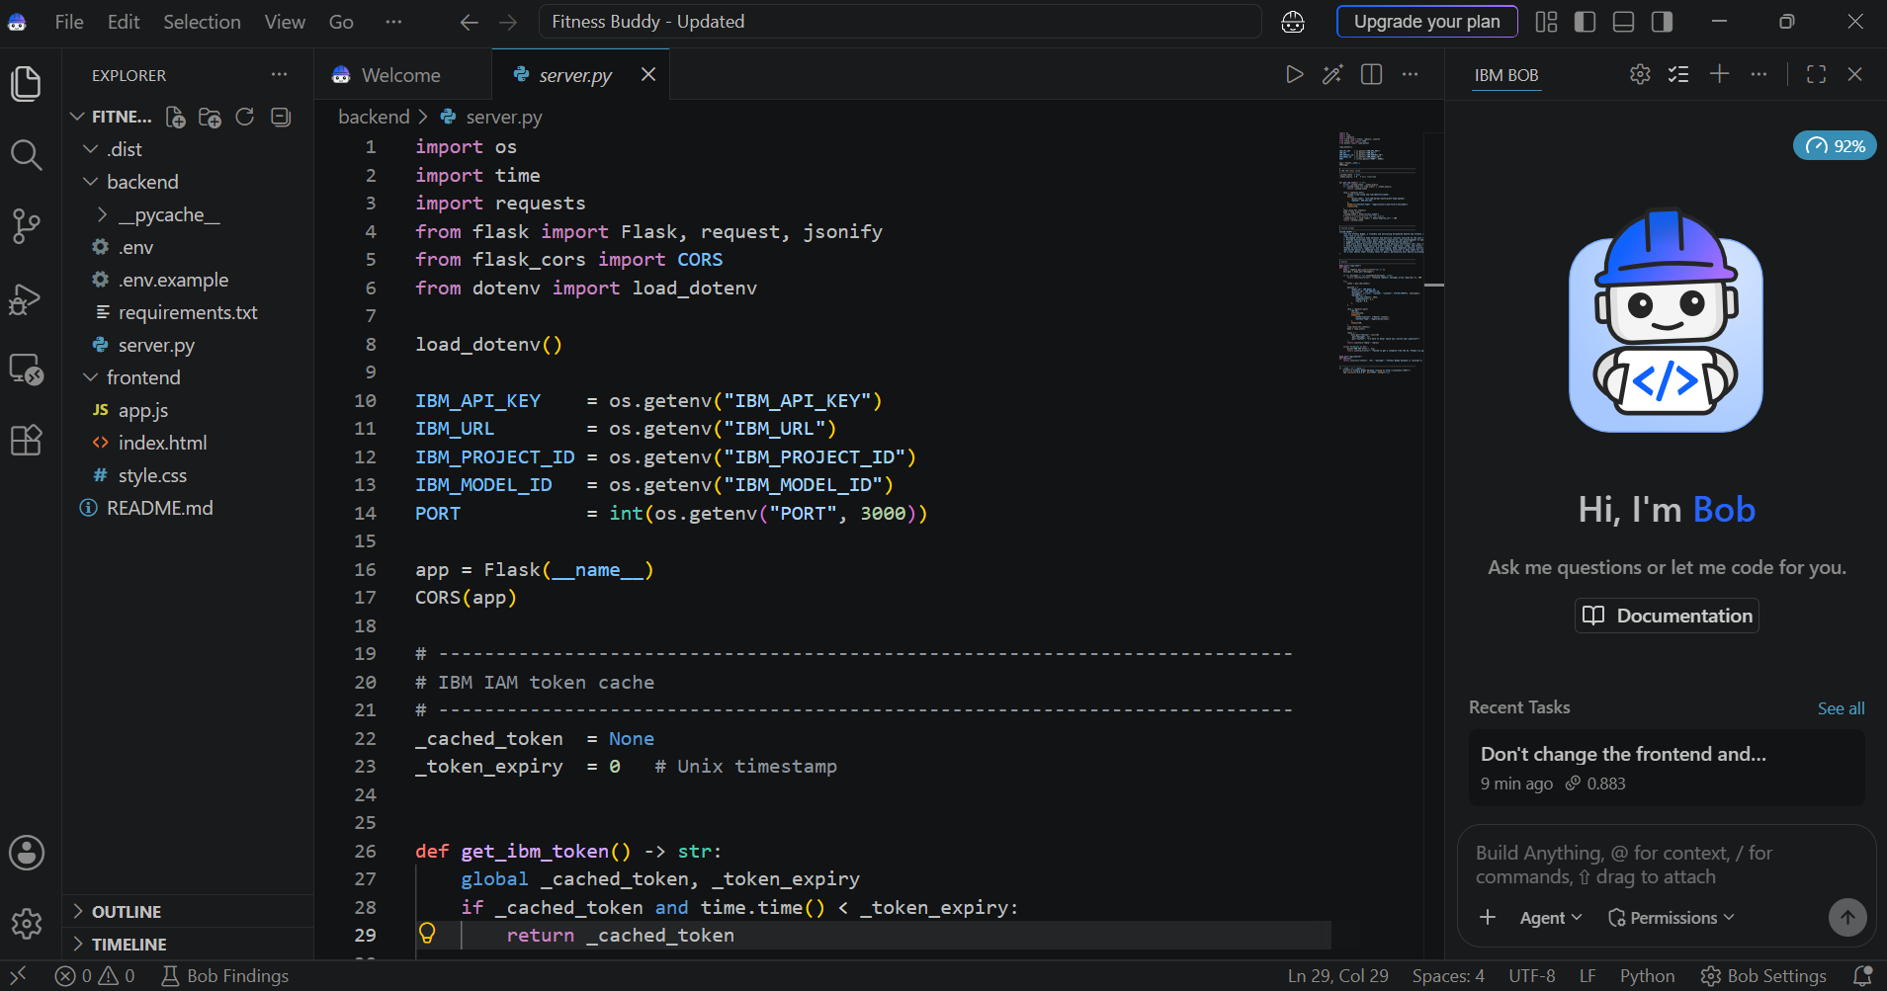

Slide 11
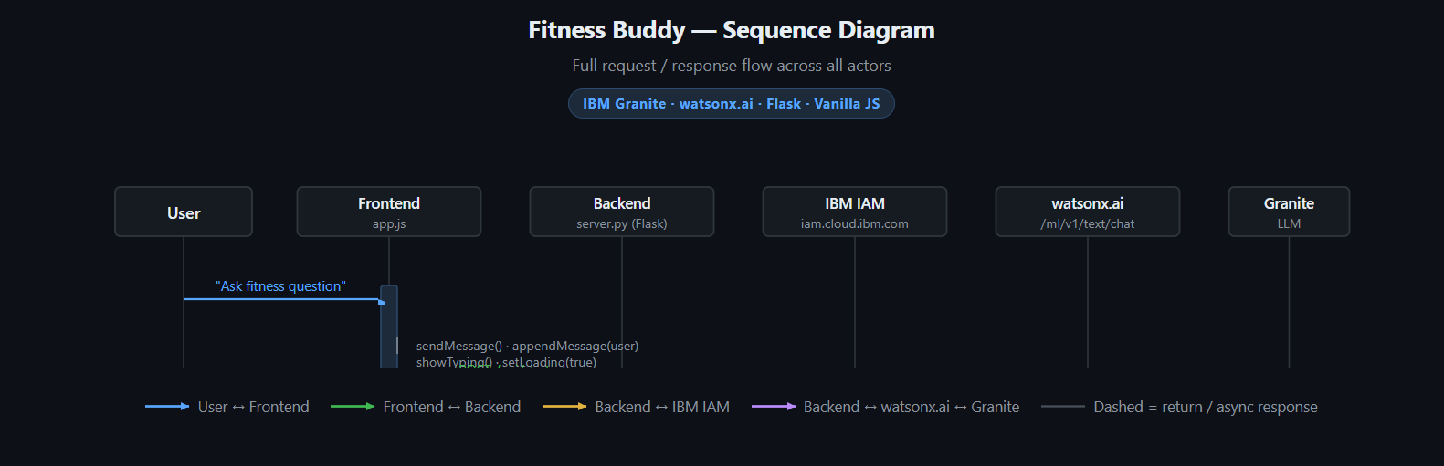
Architecture blueprint for IBM bob:

Slide 12

Role of Agentic AI in the solution
Role of Agentic AI in Fitness Buddy
Agentic AI enables Fitness Buddy to work as an intelligent fitness assistant rather than just a simple chatbot. Using IBM watsonx.ai and IBM Granite, it understands user requests and provides personalized fitness guidance.
The AI helps with different tasks such as suggesting home workouts, providing meal ideas, giving motivation, supporting habit building, and sharing weight loss and recovery tips.
It also provides context-aware responses by understanding the user's input and adapting the suggestions according to their needs and goals.
Agentic AI allows Fitness Buddy to respond to different fitness-related questions and provide personalized and relevant recommendations through a conversational interface.
Overall, Agentic AI makes Fitness Buddy a smart, personalized fitness assistant that helps users stay motivated and maintain a healthy lifestyle.

Slide 13
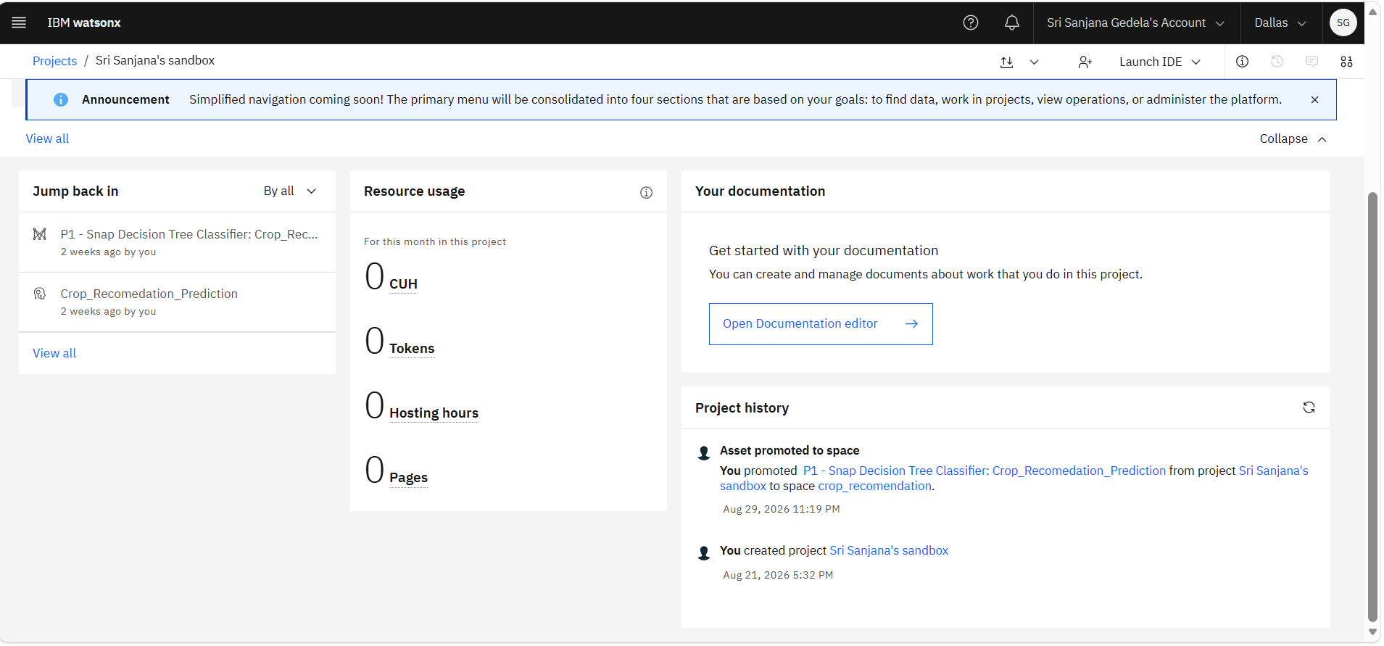
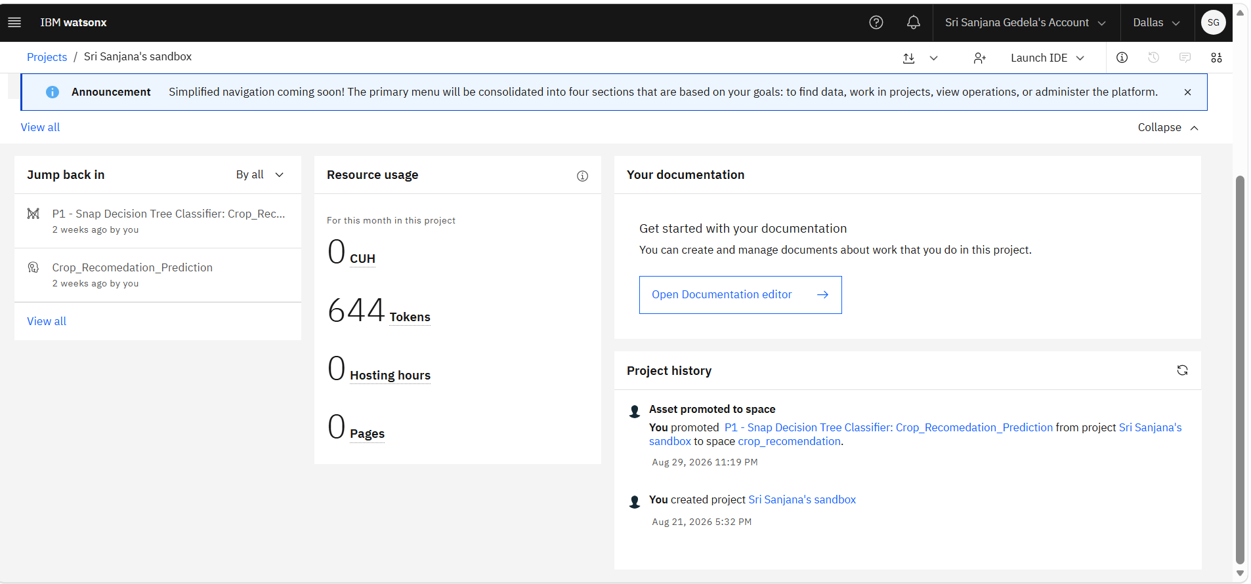
Token Usage
644 token are used
Before Prompt
After the Prompt
·
·
·

Slide 14
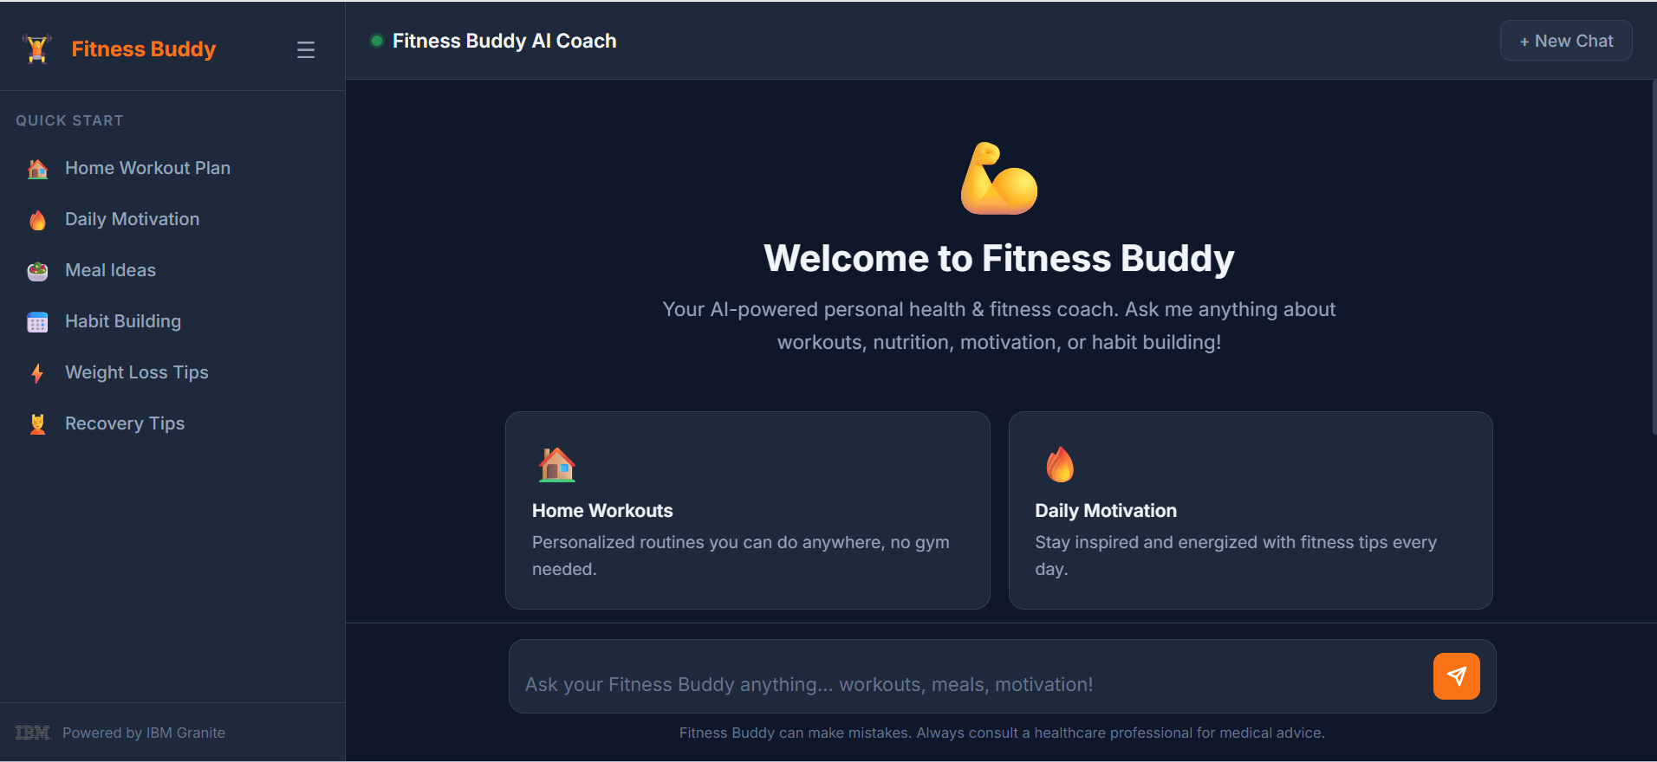
Project Output Screenshot

Slide 15
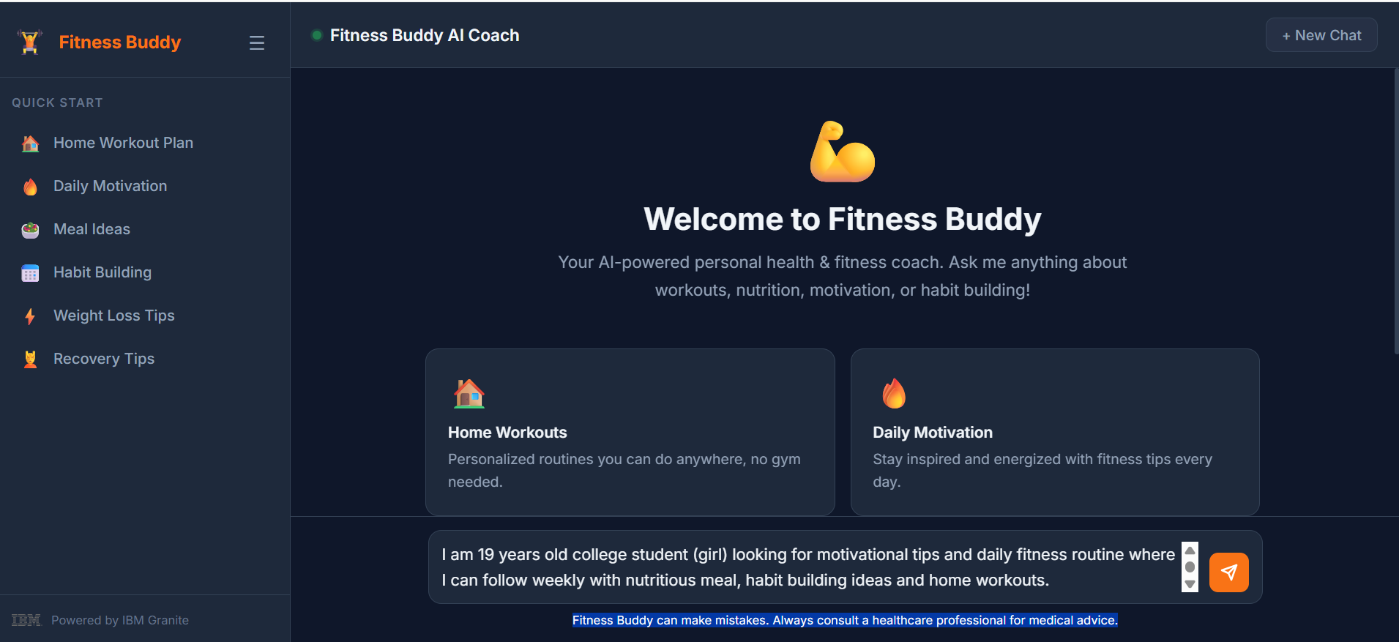
Project Output Screenshot
1.Prompt:
I am 19 years old college student (girl) looking for motivational tips and daily fitness routine where I can follow weekly with nutritious meal, habit building ideas and home workouts.

Slide 16
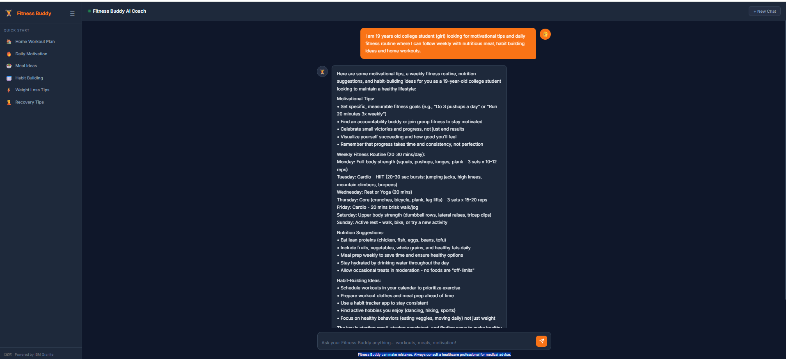
Project Output Screenshot

Slide 17
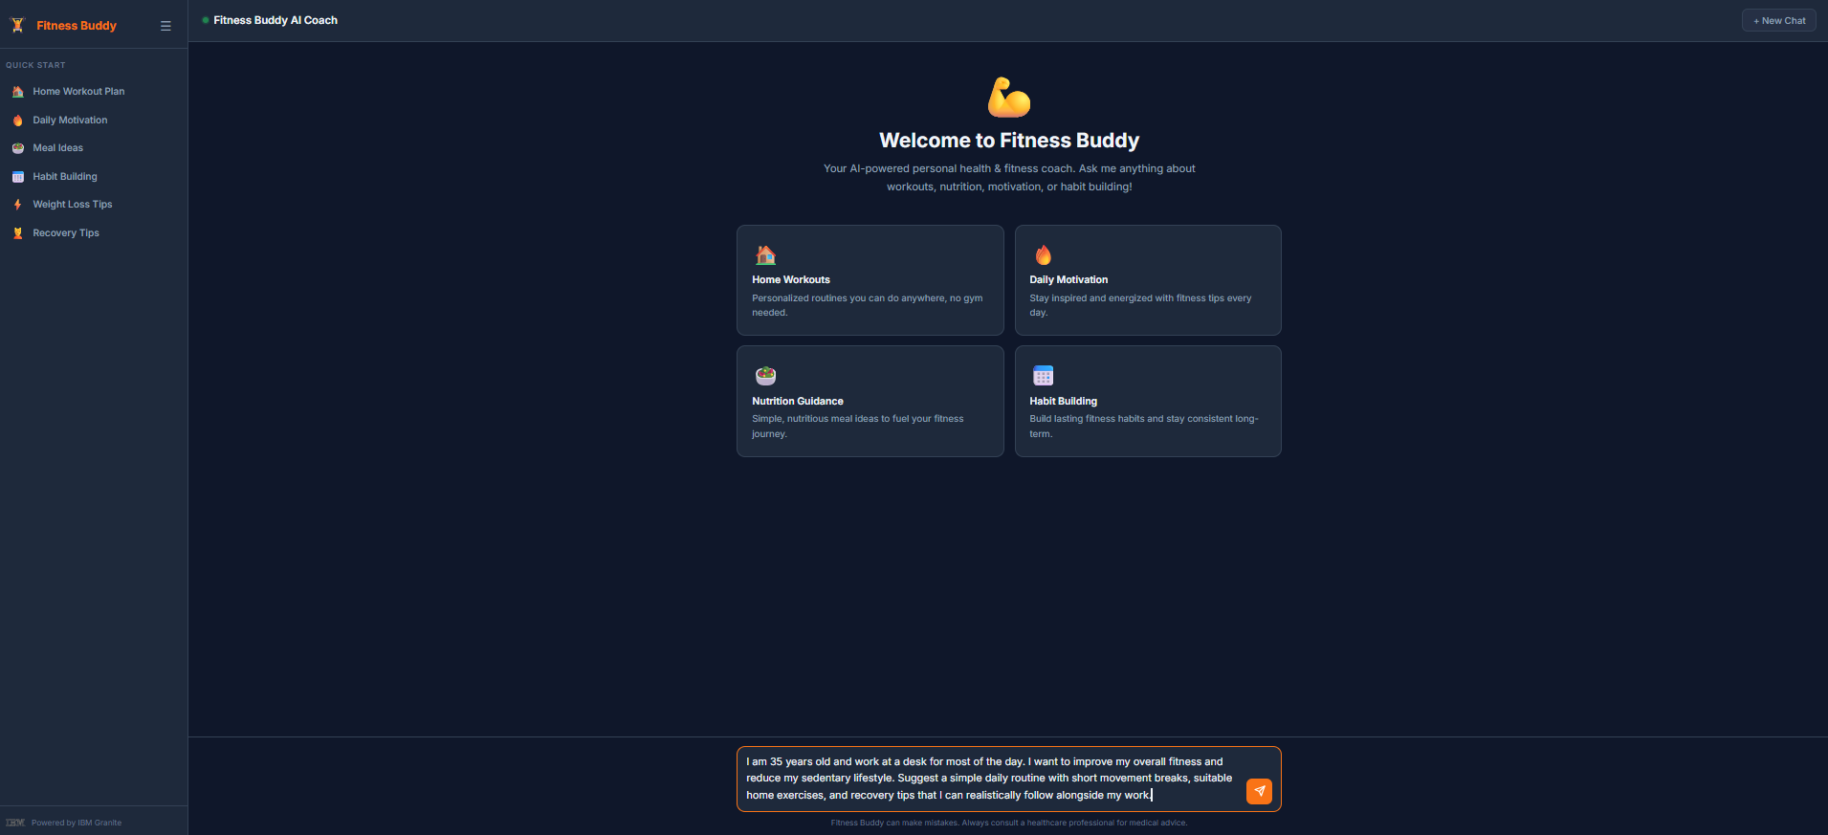
Project Output Screenshot
2. Prompt:
I am 35 years old and work at a desk for most of the day. I want to improve my overall fitness and reduce my sedentary lifestyle. Suggest a simple daily routine with short movement breaks, suitable home exercises, and recovery tips that I can realistically follow alongside my work.

Slide 18

Project Output Screenshot

Slide 19
Novelty and Uniqueness
The proposed Fitness Buddy stands out by combining Agentic AI and personalization into a single fitness-focused system.
Personalized Fitness Guidance – Provides fitness suggestions based on the user's needs, goals, and preferences.
AI Fitness Assistance – Uses AI to provide workout, meal, motivation, habit-building, weight loss, and recovery guidance.
Conversational Interaction – Allows users to interact naturally with Fitness Buddy and ask questions related to their fitness and healthy lifestyle.
Adaptive Recommendations – Adjusts the guidance based on the user's input and requirements.
Multiple Fitness Features – Combines home workouts, meal ideas, motivation, habit building, weight loss tips, and recovery tips in one platform.
IBM Granite Integration – Uses IBM Granite through IBM watsonx.ai to generate personalized fitness-related responses.
This makes Fitness Buddy a personalized and interactive AI fitness assistant, rather than just a basic fitness information platform.

Slide 20
Git Hub Link
https://github.com/Sanjanag-611/Fitness-Buddy
·
·
·

Slide 21
Future Scope
Integration with Wearables & Fitness Devices – The system can be integrated with smartwatches and fitness trackers to collect data such as steps, calories burned, heart rate, and sleep patterns. This can help Fitness Buddy provide more personalized fitness guidance based on the user’s activity and health data.
AI-Powered Voice Assistant & Multilingual Support – Fitness Buddy can be enhanced with a voice-enabled assistant and support for multiple languages, allowing users to interact naturally in their preferred language and making the solution more accessible to different users.

Slide 22
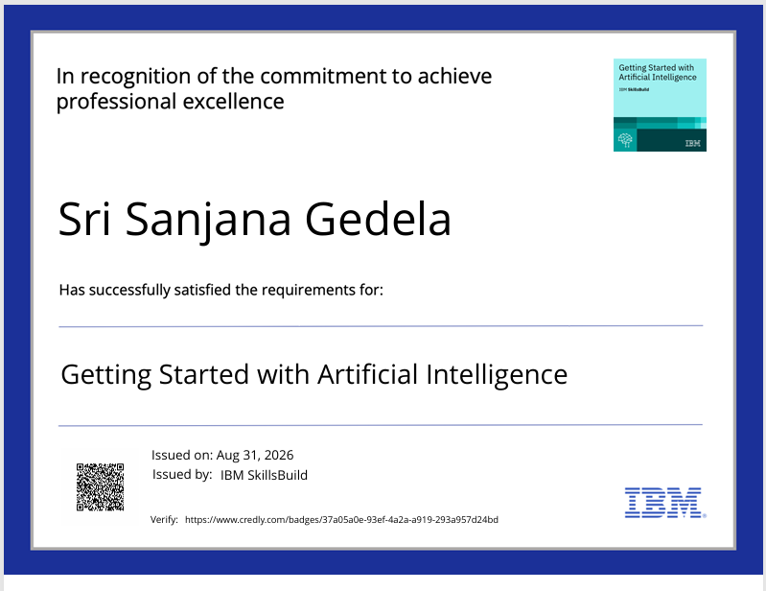
Certificates Earned:

Slide 23
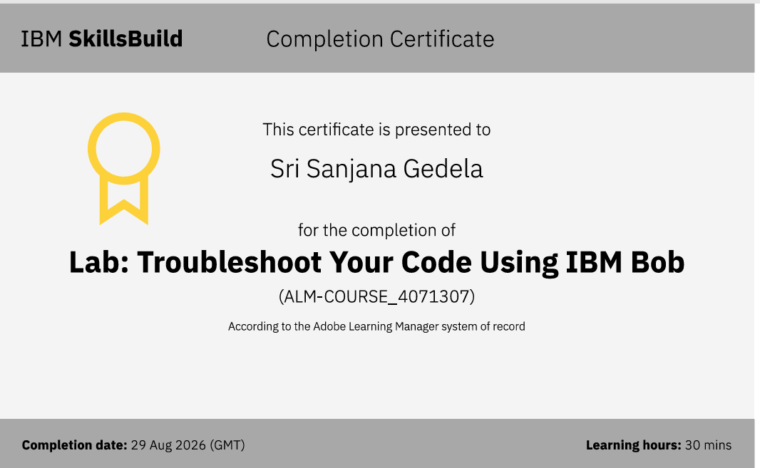
Certificates Earned:​

Slide 24


